Slide 1
Inclusive Language Commitment
Arm is committed to making the language we use inclusive, meaningful, and respectful. Our goal is to remove and replace non-inclusive language from our vocabulary to reflect our values and represent our global ecosystem.
Arm is working actively with our partners, standards bodies, and the wider ecosystem to adopt a consistent approach to the use of inclusive language and to eradicate and replace offensive terms. We recognise that this will take time. This course contains references to non-inclusive language; it will be updated with newer terms as those terms are agreed and ratified with the wider community. We recognise that some of you will be accustomed to using the previous terms and may not immediately recognise their replacements. Please refer to the following examples:
When introducing edge-triggered Flip-Flop, we will use the term ‘JK Flip-flop’ instead of ‘master-slave flip-flop’.
Contact us at education@arm.com with questions or comments about this course. You can also report non-inclusive and offensive terminology usage in Arm content at terms@arm.com.

Slide 2
CMOS VLSI Design Lecture 1: Introduction
Notes:
Hello and welcome to the CMOS VLSI Design course.

Slide 3
Course Learning Objectives
At the end of this course, you should be able to:
Design a custom digital integrated circuit using commercial CAD tools
Interpret, analyze, and design cells and components at the schematic and layout levels
Analyze delay and power consumption analytically and through simulation
Select appropriate structures for combinational and sequential circuits, and datapath and memory components
Describe considerations for reliability and testability
Notes:
By the end of this course, you should be able to:
Design a custom digital integrated circuit using commercial computer-aided design (CAD) tools
Interpret, analyze, and design cells and components at the schematic and layout levels
Analyze delay and power consumption analytically and through simulation
Select appropriate structures for combinational and sequential circuits, datapath and memory components
Describe considerations for reliability and testability

Slide 4
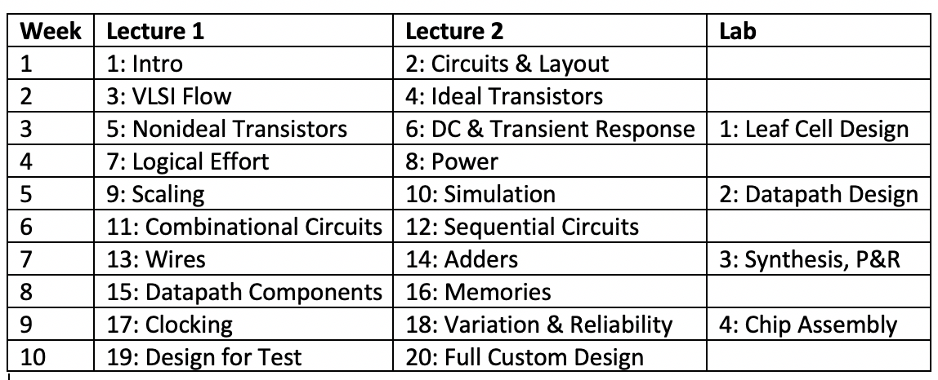
Sample Course Schedule
Notes:
This course comprises 20 lectures with 4 labs, which can be split between 10 weeks.

Slide 5
This Lecture’s Learning Objectives
At the end of this lecture, you should be able to:
Describe the properties of nMOS and pMOS transistors which enables them to be used as digital switches.
Draw schematic of simple logic gates using a combination of nMOS and pMOS transistors.
Sketch the cross-sections of a CMOS inverter.
List the fabrication steps of a CMOS inverter.
Notes:
At the end of this lecture, you should be able to:
Describe the properties of nMOS and pMOS transistors which enables them to be used as digital switches.
Draw schematic of simple logic gates using a combination of nMOS and pMOS transistors.
Sketch the cross-sections of a CMOS inverter.
List the fabrication steps of a CMOS inverter.

Slide 6
Introduction
Integrated circuits: many transistors on one chip.
Very Large-Scale Integration (VLSI): bucketloads!
Complementary Metal Oxide Semiconductor
Fast, cheap, low power transistors
Today: How to build your own simple CMOS chip
CMOS transistors
Building logic gates from transistors
Transistor layout and fabrication
Rest of the course: How to build a good CMOS chip
Notes:
Some key concepts used frequently in this course.
IC or Integrated Circuits contain many transistors on one chip.
VLSI or Very Large-Scale Integration is creating IC by combining many transistors in a single chip.
CMOS or Complementary Metal Oxide Semiconductor is a fast, cheap, and low power transistor. CMOS technology has the advantages of reduced circuit complexity and high density of logic function.
We will look at how to build a simple CMOS chip by making use of the rich features of the tools provided by Cadence and Synopsys for schematic capture, layout editing, HDL synthesis and layout routing; both manual and auto routing. In the rest of the course, we will look at how to build a good chip by harnessing the rich features of the tools.

Slide 7
Silicon Lattice
Transistors are built on a silicon substrate
Silicon is a Group IV material
Forms crystal lattice with bonds to four neighbors
Notes:
Transistors are built on a silicon substrate. In semiconductor physics, silicon is a Group IV material (Group 14 if using the new IUPAC numbering) that forms a crystal lattice with bonds to four neighbors.

Slide 8
Dopants
Silicon is a semiconductor
Pure silicon has no free carriers and conducts poorly
Adding dopants increases the conductivity
Group V: extra electron (n-type)
Group III: missing electron, called hole (p-type)
Notes:
Silicon is a semiconductor.
In its pure form, silicon has no free carriers and conducts poorly.
A dopant or doping agent is a trace of impurity element added to a semiconductor material to alter or change its electrical characteristic such as its conductivity.
Adding dopants increases the conductivity of Silicon. A doping agent can either be an electron donor or an electron acceptor. An electron donor dopant causes the doped semiconductor to have negative electrons as majority charge carriers. An electron acceptor dopant creates a hole in the doped semiconductor.
An extra electron to Silicon creates an n-type silicon, a common dopant used for this process is phosphorus or arsenic
Whereas if the Silicon is missing an electron or there is a so-called “hole” in the Silicon, this creates a p-type silicon. A common dopant used for this process is Boron or gallium.

Slide 9
p-n Junctions
A junction between p-type and n-type semiconductor forms a diode.
Current flows only in one direction
Notes:
A p-n junction forms a diode which allows current to flow only in one direction.

Slide 10
nMOS Transistor
Four terminals: gate, source, drain, body
Symbol shows gate, source, drain
Usually omits body
Source and drain are logically indistinguishable
Notes:
A nMOS transistor is made of four terminals: gate, source, drain, and body.
Its electronic symbol for a nMOS transistor shows the gate, source, and drain – the body terminal is usually omitted.
The source and drain are logically indistinguishable, as shown in the diagram.

Slide 11
nMOS Transistor
Gate – oxide – body stack looks like a capacitor
Gate and body are conductors
Body is lightly doped p-type
Gate is a metal or polycrystalline silicon (polysilicon)
SiO₂ (oxide) is an excellent insulator
Called metal – oxide – semiconductor (MOS) capacitor
Source and drain are heavily doped (n+) silicon
Notes:
In the diagram shown, note that the Gate, the oxide or Silicon dioxide, and the body forms a stack that looks like a capacitor.
The silicon oxide SiO₂ between the gate and the body acts as an excellent insulator between both. The body is a lightly doped p-type silicon, and the gate is a metal or polycrystalline silicon (polysilicon).
The gate–oxide–body stack is called metal-oxide-semiconductor (MOS) capacitor.
The source and drain are heavily doped (n+) silicon.

Slide 12
nMOS Operation
Body is usually tied to ground (0 V)
When the gate is at a low voltage:
P-type body is at low voltage
Source-body and drain-body diodes are OFF
No current flows, transistor is OFF
Notes:
To operate a nMOS transistor, the body is connected to ground or zero voltage, and the gate will either be at a low or high voltage.
When the gate is at a low voltage:
The source-body and drain-body diodes are OFF, no current flows, and the transistor is OFF.

Slide 13
nMOS Operation Cont.
When the gate is at a high voltage:
Positive charge on gate of MOS capacitor
Negative charge attracted to body
Inverts a channel under gate to n-type
Now current can flow through n-type silicon from source through channel to drain, transistor is ON
Notes:
However, when the gate is at a high voltage:
There is a positive charge on the gate of the MOS capacitor which attracts the negative charge in the body.
This creates an inverted channel under the gate to the n-type silicon. Now, current can flow through the n-type silicon from source through channel to drain. The transistor is ON.

Slide 14
pMOS Transistor
Similar, but doping and voltages reversed
Body tied to high voltage (V_{DD})
Gate low: transistor ON
Gate high: transistor OFF
Bubble indicates inverted behavior
Notes:
A pMOS transistor operates in the same way as a nMOS transistor, except that the doping and voltages are reversed.
The body is connected to a high voltage.
A low voltage applied to the gate causes the transistor to turn ON, whereas a high voltage at the gate causes the transistor to be OFF.
The bubbles (circles) in the schematic symbol indicate this inverted behavior.

Slide 15
Power Supply Voltage
GND = 0 V
In 1980’s, V_{DD} = 5 V
V_{DD} has decreased in modern processes
High V_{DD} would damage modern tiny transistors
Lower V_{DD} saves power
V_{DD} = 3.3, 2.5, 1.8, 1.5, 1.2, 1.0, 0.8, 0.7, …
Gradually scaling down as transistors shrink
Notes:
Some basic terms of power supply voltage:
GND or ground is equal to zero volts.
VDD or “Voltage Drain Drain” is the DC voltage that is supplied to the drain of the transistor.
In the 80’s, the standard VDD was 5 Volts.
VDD has decreased in modern processes as lower VDD saves power.
As seen in this slide, VDD gradually scales down as transistors shrink.

Slide 16
Transistors as Switches
We can view MOS transistors as electrically controlled switches
Voltage at gate controls path from source to drain
Notes:
MOS transistors behave as electrically controlled switches. Voltage applied to the gates control the path from source to drain.

Slide 17
CMOS Inverter
A | Y
0 | 1
1 | 0
OFF
ON
0
1
ON
OFF
Notes:
The behavior of transistors enables us to build logic gates such as an inverter, NAND, NOR, etc.
The circuit shown in this slide is an inverter. It operates thus:
A is the input, Y is the output.
When A in high (1), the pMOS gate is open while the nMOS gate is closed. This connects the output Y to GND (Y will be in a low state or 0).
When A in low (0), the pMOS gate is closed while the nMOS gate is open. This connects the output Y to VDD (Y will be in a high state or 1).

Slide 18
CMOS NAND Gate
A | B | Y
0 | 0 | 1
0 | 1 | 1
1 | 0 | 1
1 | 1 | 0
OFF
ON
OFF
OFF
OFF
ON
ON
ON
1
1
0
0
ON
ON
OFF
OFF
1
0
1
0
ON
OFF
ON
OFF
Notes:
The circuit shown in this slide is a NAND gate. It operates thus:
A and B are the inputs, Y is the output.
When A and B are both low (0), both pMOS gates are closed while both nMOS gates are open. This connects the output Y to VDD (Y will be in a high state or 1).
When either A or B is low (0), the pMOS gate with the low input is closed and the other open while the nMOS gate with the high input is closed wand the other nMOS is open. This connects the output Y to VDD (Y will be in a high state or 1). Note that the path to GND is not complete because one of both nMOS transistors will be OFF.
When A and B are both high (1), both pMOS gates are open while both nMOS gates are closed. This connects the output Y to GND (Y will be in a low state or 0).

Slide 19
CMOS NOR Gate
A | B | Y
0 | 0 | 1
0 | 1 | 0
1 | 0 | 0
1 | 1 | 0
Notes:
The circuit shown in this slide is a NOR gate. It operates thus:
A and B are the inputs, Y is the output.
When A and B are both low (0), both pMOS gates are closed while both nMOS gates are open. The closed pMOS transistors create a path to Vdd, connecting the output Y to VDD (Y will be in a high state or 1).
When either A or B is low (0), the pMOS gate with the low input is closed and the other open while the nMOS gate with the high input is closed and the other nMOS is open. The path to VDD from point Y is not complete, however the path to GND exist since either of the nMOS transistors are ON. Therefore Y will be in a low state or 0.
When A and B are both high (1), both pMOS gates are open while both nMOS gates are closed. This connects the output Y to GND (Y will be in a low state or 0).

Slide 20
3-input NAND Gate
Y pulls low if ALL inputs are 1
Y pulls high if ANY input is 0
Notes:
A little complexity, build 3 input NAND Gate, Y pulls low if ALL inputs are 1, otherwise pulls high.

Slide 21
CMOS Fabrication
CMOS transistors are fabricated on silicon wafer
Lithography process similar to printing press
On each step, different materials are deposited or etched
Easiest to understand by viewing both top and cross-section of wafer in a simplified manufacturing process
Notes:
The CMOS transistors are fabricated on silicon wafer.
Using a process known as Lithography, patterns can be placed in the silicon wafer like printing press.
On each step of the CMOS fabrication, different materials are deposited or etched.
Let’s understand this by looking at the top and cross-section of wafer in a simplified manufacturing process.

Slide 22
Inverter Cross-section
Typically use p-type substrate for nMOS transistors
Requires n-well for body of pMOS transistors
So pMOS p-type source/drain doesn’t short to p-type substrate
Notes:
This diagram represents the cross-sectional view of a CMOS inverter.
In the diagram, for the nMOS transistors, p-type substrate is used for the body.
Whereas pMOS transistors require a n-well to avoid its p-type source and drain shorting with p-type substrate from the nMOS transistor.

Slide 23
Well and Substrate Taps
Substrate must be tied to GND and n-well to V_{DD}
Metal to lightly doped semiconductor forms poor connection called Schottky Diode
Use heavily doped well and substrate contacts/taps
Notes:
The p substrate needs to be tied to GND and n-well to VDD.
There are metal connections (blue) with the lightly doped semiconductors that form poor connection called Schottky Diode. To improve these connections, heavily doped well and substrate contacts/taps are used to provide a low-resistance connection path to the body.

Slide 24
Inverter Mask Set
Transistors and wires are defined by masks
Cross-section taken along dashed line
Notes:
Transistors and wires are defined by masks.
This CMOS inverter mask set will look like this.
The dashed line represents the cross-section in the previous slides.

Slide 25
Detailed Mask Views
Six masks
n-well
Polysilicon
n+ diffusion
p+ diffusion
Contact
Metal
Notes:
There are in total 6 masks:
n-well
Polysilicon
n+ diffusion
p+ diffusion
Contact
Metal

Slide 26
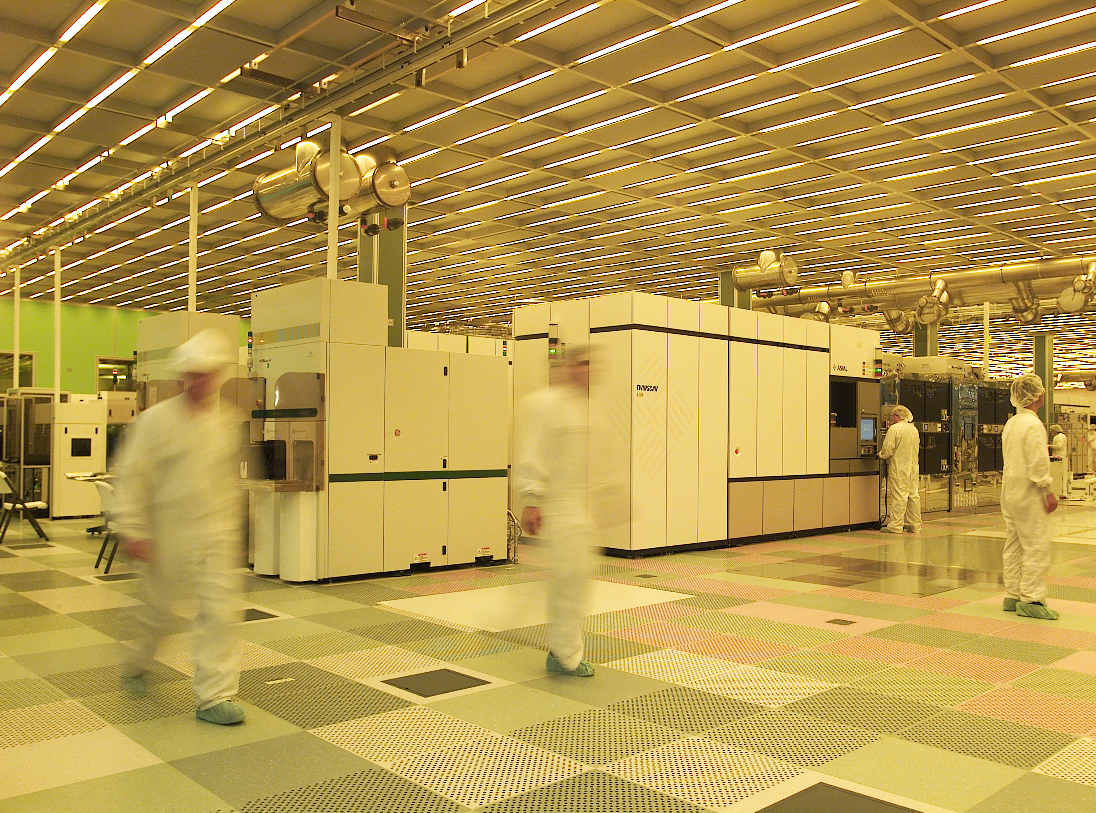
Fabrication
Chips are built in huge factories called fabs
Contain clean rooms as large as football fields, costing billions of dollars
Courtesy of International
Business Machines Corporation.
Unauthorized use not permitted.
Notes:
Fabrication of chips are done in huge factories called fabs containing clean rooms as large as football fields and costing billions of dollars.

Slide 27
Fabrication Steps
Start with blank wafer
Build inverter from the bottom up
First step will be to form the n-well
Cover wafer with protective layer of SiO₂ (oxide)
Remove layer where n-well should be built
Implant or diffuse n dopants into exposed wafer
Strip off SiO₂
Notes:
How CMOS is fabricated here, we will see the steps to create our own CMOS inverter.
Start with a blank wafer and build the inverter from the bottom up.
First step will be to form the n-well. To do this:
Cover the wafer with a protective layer of SiO2 (oxide)
Remove the layer where the n-well should be built
Implant or diffuse n dopants into the exposed wafer
And strip off the SiO2

Slide 28
Oxidation
Grow SiO₂ on top of Si wafer
900 – 1200 ℃ with H₂O or O₂ in oxidation furnace
Notes:
Through the use of oxidation, we grow SiO₂ on top of Si wafer. To do this, the temperature needs to be in the range of 900 to 1200 Celsius degrees with H₂0 or 0₂ in an oxidation furnace.

Slide 29
Photoresist
Spin on photoresist
Photoresist is a light-sensitive organic polymer
Softens where exposed to light
Notes:
Next, a photoresist is placed on top of SiO₂. This material is a light-sensitive organic polymer and changes when exposed to light.

Slide 30
Lithography
Expose photoresist through n-well mask
Strip off exposed photoresist
Notes:
Use lithography to expose photoresist through n-well mask and strip off the exposed part.

Slide 31
Etch
Etch oxide with hydrofluoric acid (HF)
Seeps through skin and eats bone, nasty stuff!!!
Only attacks oxide where resist has been exposed
Notes:
Now etch oxide with hydrofluoric acid; this is used to attack the oxide where the resist has been exposed.

Slide 32
Strip Photoresist
Strip off remaining photoresist
Use a mixture of acids called piranha etch
Resist doesn't melt in the next step
Notes:
Strip off the remaining photoresist using a mixture of acids called piranha etch so resist doesn’t melt in the next step.

Slide 33
n-well
n-well is formed with diffusion or ion implantation
Diffusion
Place wafer in furnace with arsenic gas
Heat until As atoms diffuse into exposed Si
Ion Implantation
Blast wafer with a beam of As ions
Ions blocked by SiO₂, only enter exposed Si
Notes:
The n-well is formed with diffusion or ion implantation
For diffusion:
The wafer is placed in furnace with arsenic gas and heated until the Arsenic atoms diffuse into the exposed Si.
For ion implantation:
The wafer is blasted with a beam of arsenic ions. These ions are blocked by SiO₂ and can only enter the exposed Si.

Slide 34
Strip Oxide
Strip off the remaining oxide using HF
Back to bare wafer with n-well
Subsequent steps involve similar series of steps
Notes:
Hydrofluoric acid is used to strip off the remaining oxide, resulting in a bare wafer with n-well.

Slide 35
Polysilicon
Deposit very thin layer of gate oxide
< 20 Å (6-7 atomic layers)
Chemical Vapor Deposition (CVD) of silicon layer
Place wafer in furnace with Silane gas (SiH₄)
Forms many small crystals called polysilicon
Heavily doped to be good conductor
Notes:
Next step will be to add the gate.
To do this, a very thin layer of gate oxide is deposited.
The chemical vapor deposition (CVD) of silicon layer process is applied.
In this process, the wafer is placed in a furnace with Silane gas (SiH4) which causes it to form many small crystals called polysilicon, which are heavily doped to be a good conductor.

Slide 36
Polysilicon Patterning
Use the same lithography process to pattern polysilicon
Notes:
Then, we use lithography to pattern polysilicon.

Slide 37
Self-Aligned Process
Use oxide and masking to expose where n+ dopants should be diffused or implanted
N-diffusion forms nMOS source, drain, and n-well contact
Notes:
Next step will be to apply the self-aligned process in which oxide and masking are used to expose where n+ dopants should be diffused or implanted.
N-diffusion forms the nMOS source, drain, and n-well contact.

Slide 38
N-diffusion
Pattern oxide and form n+ regions
Self-aligned process where gate blocks diffusion
Polysilicon is better than metal for self-aligned gates because it doesn’t melt during later processing
Notes:
To create the n+ region, the process of N-diffusion is performed.
In this process, a protective layer of oxide is first formed, which is then patterned using the n-diffusion mask to expose the areas where the dopants will be added.
Since the gates are formed using polysilicon, which will not melt during n+ diffusion, a channel is created the under the gate forming a source and drain. The source and drain are automatically formed adjacent to the gate and therefore called self-aligned process.

Slide 39
N-diffusion cont.
Historically dopants were diffused
Usually ion implantation today
But regions are still called diffusion
Notes:
Nowadays, companies usually use ion implantation to add dopants rather than diffusion, but regions are still called diffusion.

Slide 40
N-diffusion cont.
Strip off oxide to complete patterning step
Notes:
Strip off oxide to complete patterning step

Slide 41
P-Diffusion
Similar set of steps form p+ diffusion regions for pMOS source and drain and substrate contact
Notes:
After the n+ diffusion, we need to use similar steps to form the p+ diffusion regions for pMOS source, drain, and substrate.

Slide 42
Contacts
Now we need to wire together the devices
Cover chip with thick field oxide
Etch oxide where contact cuts are needed
Notes:
Now create the contacts for the CMOS inverter, by first covering the chip with thick field oxide and etching the oxide where contact cuts are needed.

Slide 43
Metallization
Sputter on aluminum over whole wafer
Pattern to remove excess metal, leaving wires
Notes:
Finally, the metal mask is added.
Sputter on aluminum over whole wafer and pattern to remove excess metal, leaving wires.

Slide 44
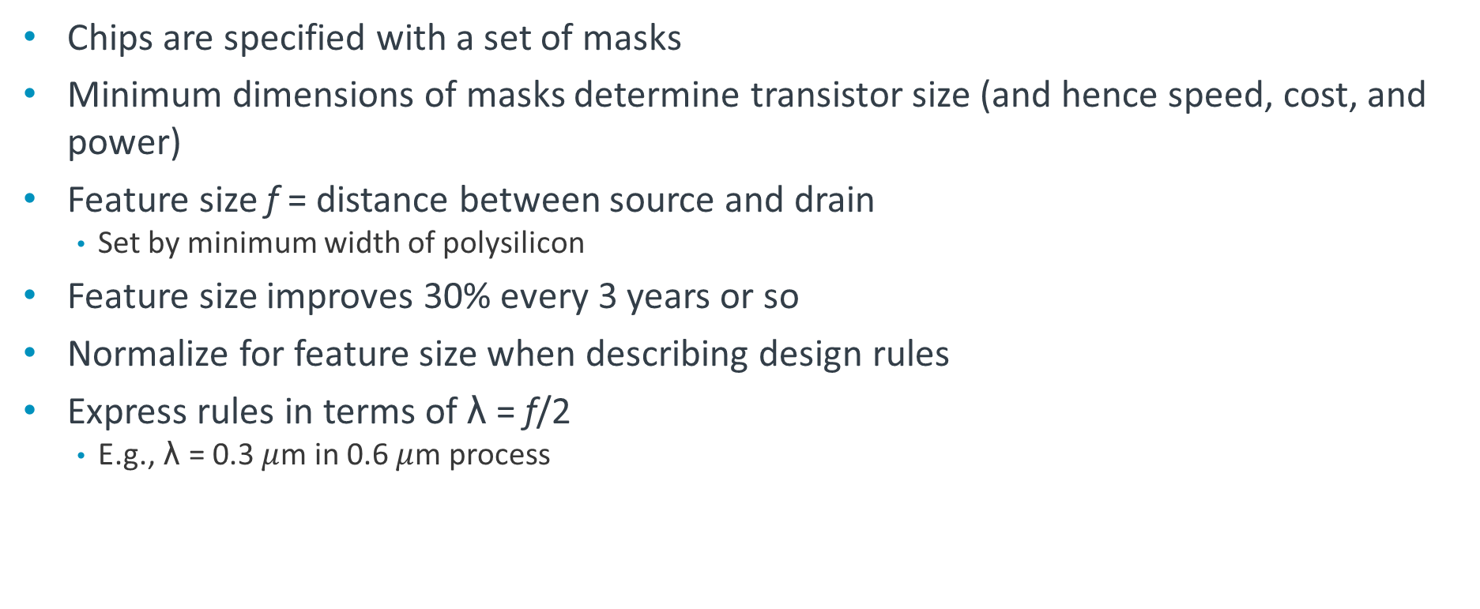
Layout
Chips are specified with a set of masks
Minimum dimensions of masks determine transistor size (and hence speed, cost, and power)
Feature size f = distance between source and drain
Set by minimum width of polysilicon
Feature size improves 30% every 3 years or so
Normalize for feature size when describing design rules
Express rules in terms of λ = f/2
E.g., λ = 0.3 $μ$m in 0.6 $μ$m process
Notes:
The layout of chips is specified with a set of masks.
Minimum dimension of masks determine transistor size.
A feature size f is equal to the distance between the source and drain.
Features size has been improving by 30% every 3 years.
It is necessary to normalize the feature size when describing design rules.
We express rules in terms of λ(lambda) = feature size/2.

Slide 45
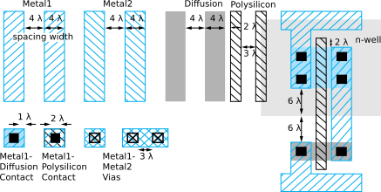
Simplified Design Rules
Conservative rules to get you started
Notes:
Here are some examples of conservative rules.

Slide 46
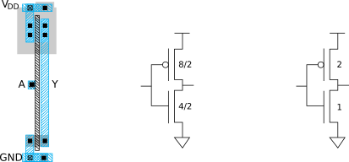

Inverter Layout
Transistor dimensions specified as Width/Length
Minimum size is 4 λ/2 λ, sometimes called 1 unit
In f = 0.6 $μ$m process, this is 1.2 $μ$m wide, 0.6 $μ$m long
Notes:
The CMOS inverter layout will look like this.
Transistor dimensions are specified as width/length, the minimum is 4/2 or sometimes called 1 unit.

Slide 47
Summary
MOS transistors are stacks of gate, oxide, silicon
Act as electrically controlled switches
Build logic gates out of switches
Draw masks to specify layout of transistors
Now you know everything necessary to start designing schematics and layout for a simple chip!

